Slide 1
Sprint 6 Demo
Tuesday, July 12th , 2022

Slide 2
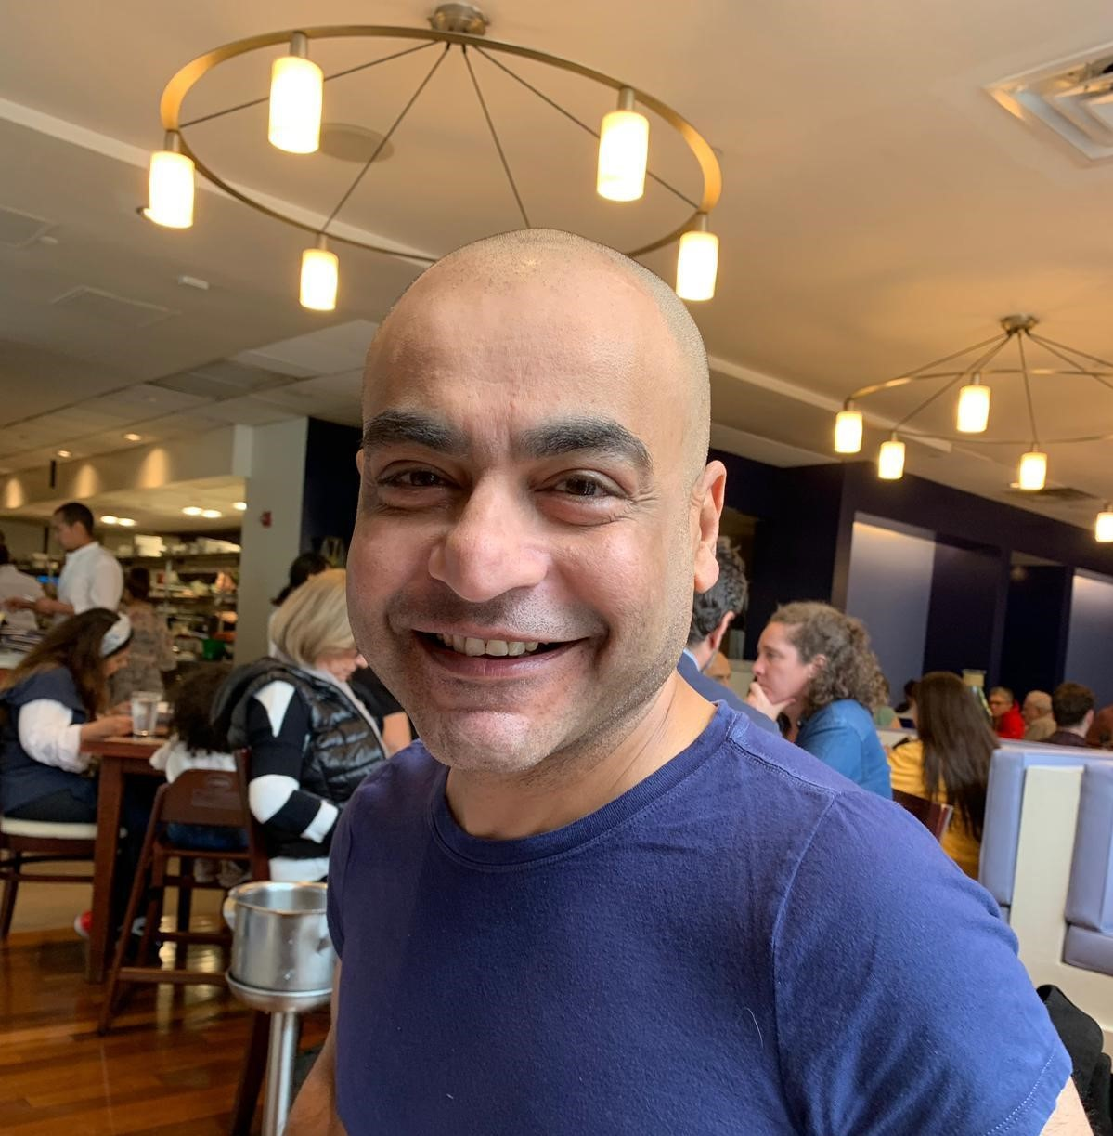
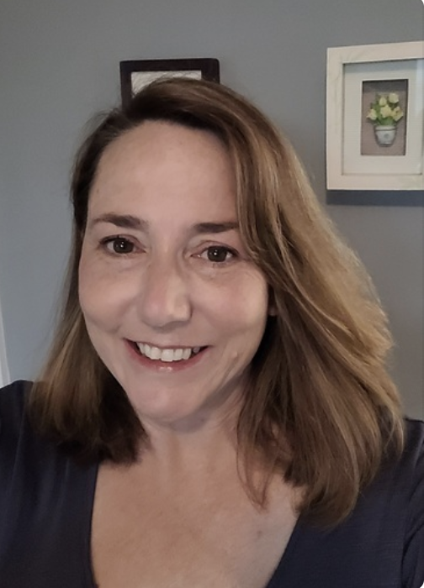
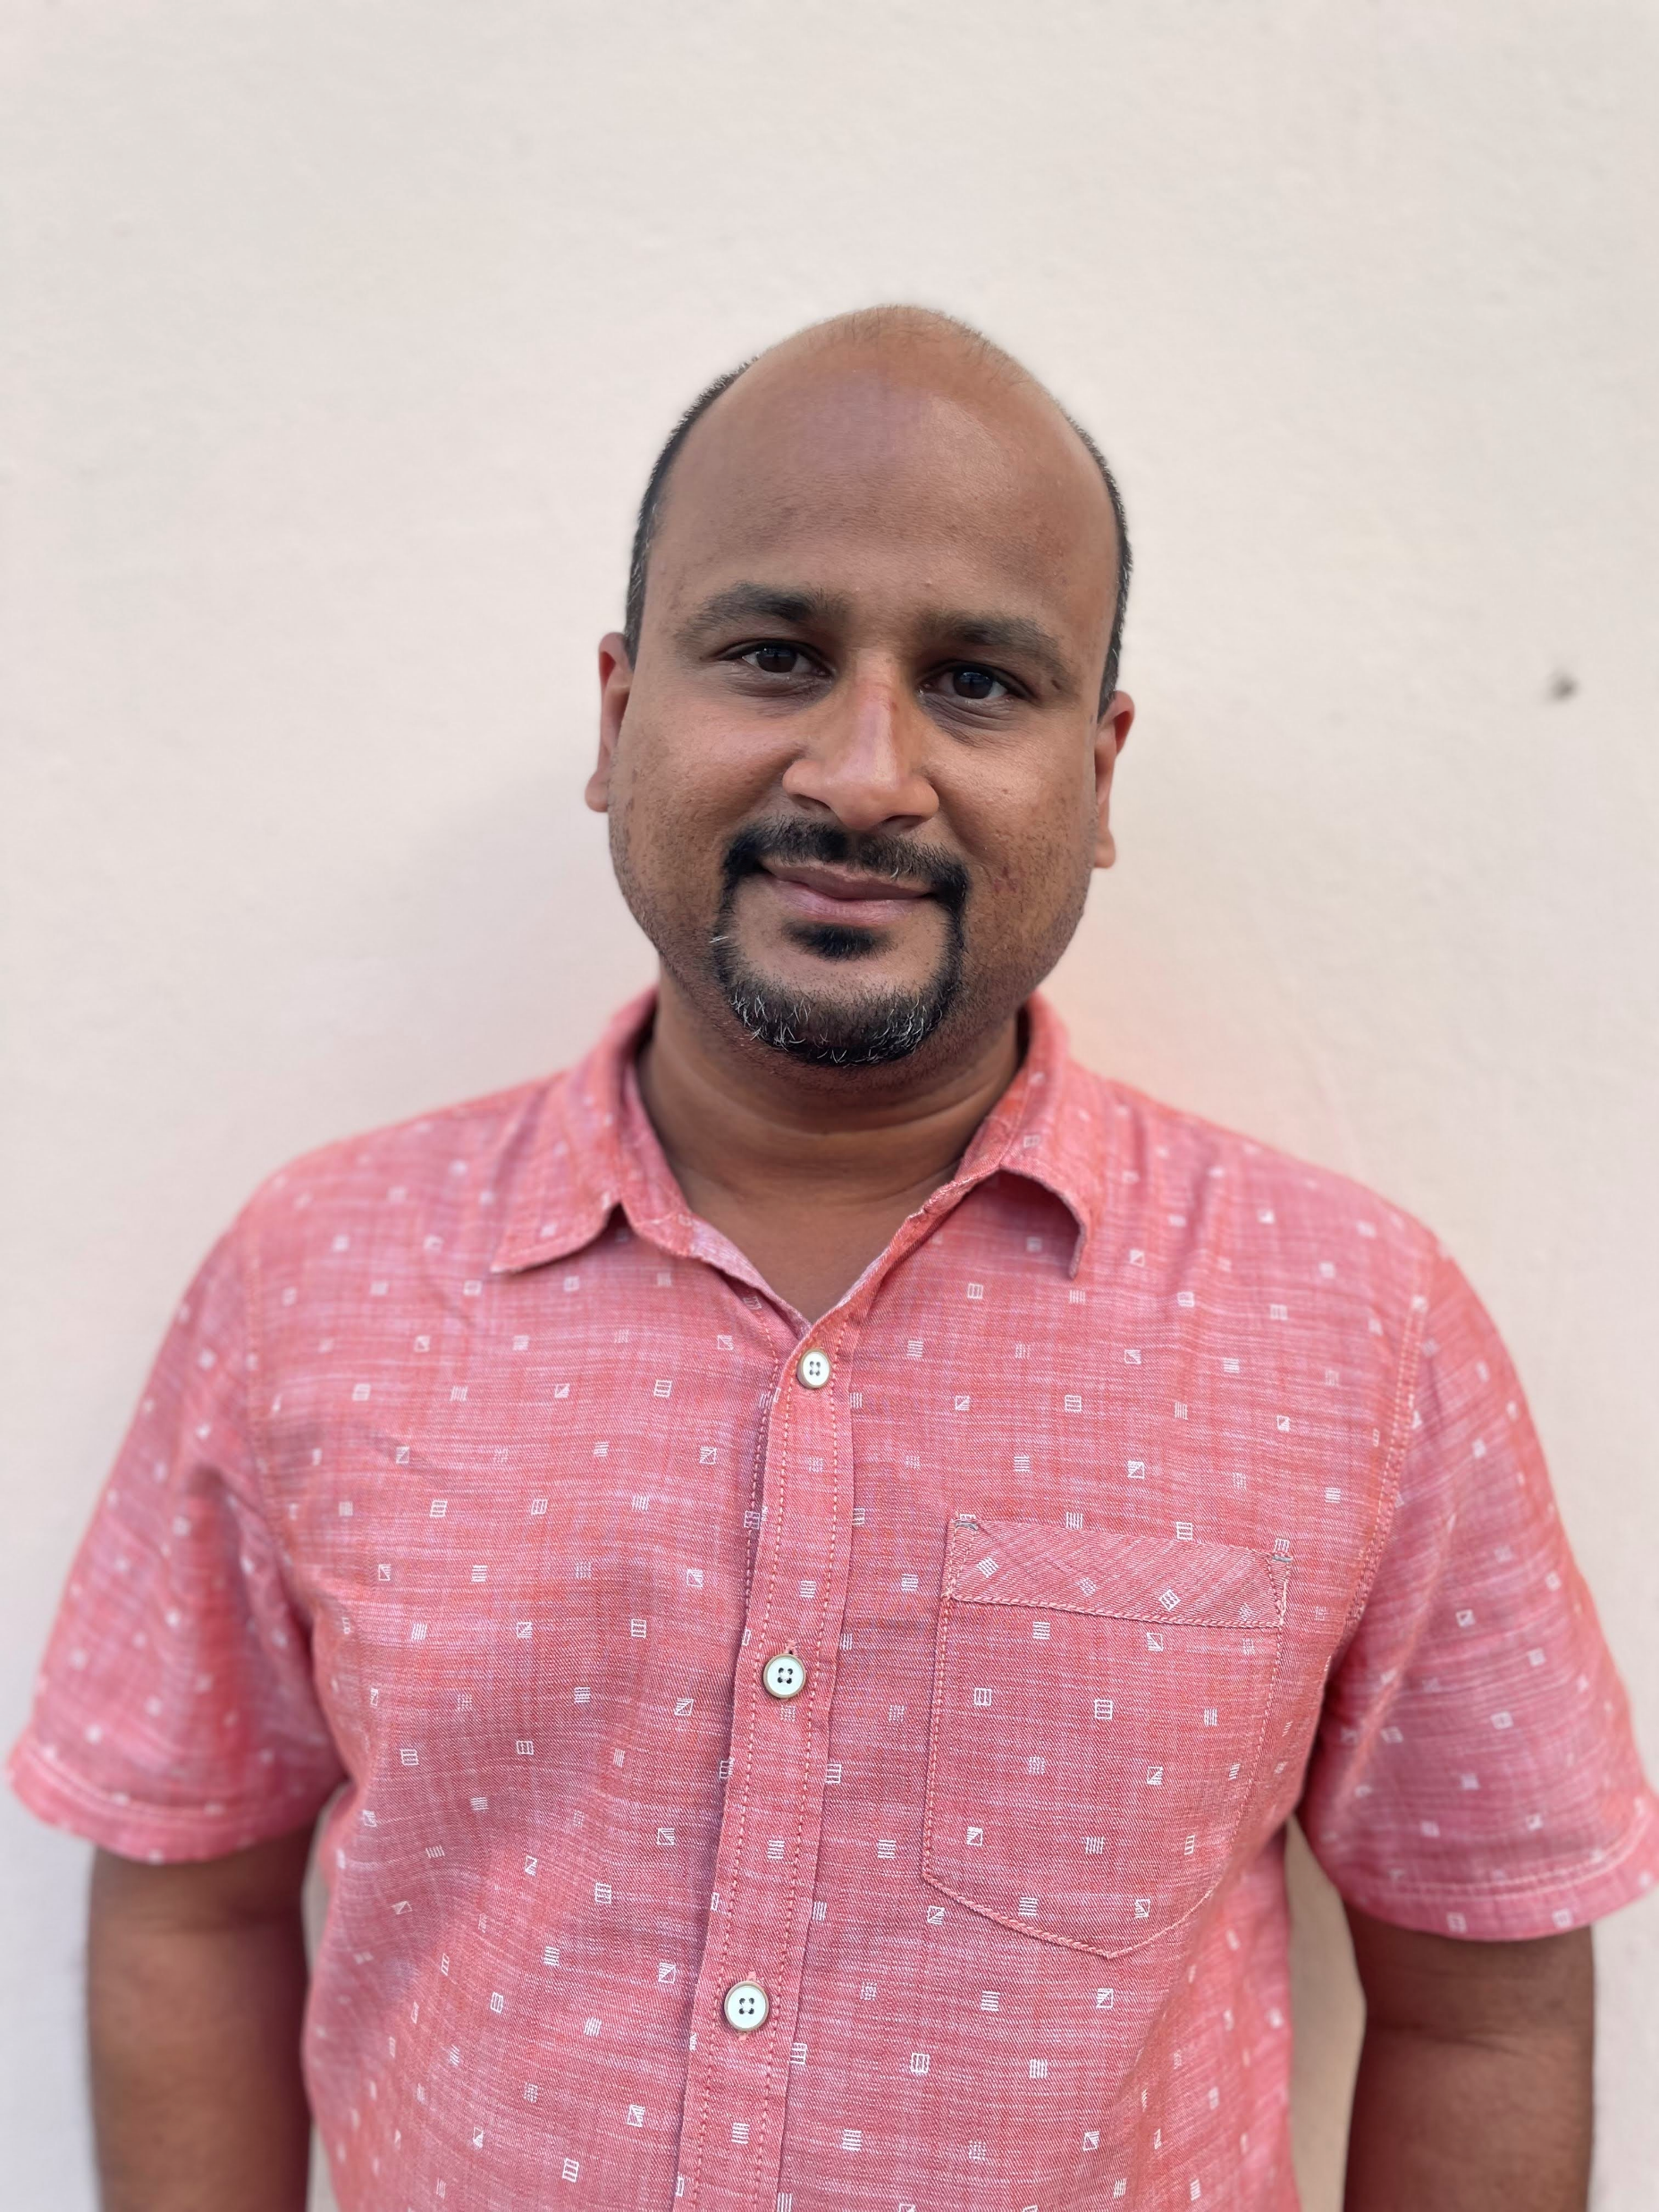










Get to know the team
Core team
Executive team
PRODUCT
ENGINEERING
Munish Sikka
Washington DC
Product Lead
Tami Corson
North Carolina
Clinical SME / Scrum
Shashank Khandelwal
Rockville, MD
Tech Lead
Jeff Scheire
MO Studio
Marcy Jacobs
McKinsey & Co
Kevin London Frog Design
DESIGN
Teagan Stephenson
Ft. Lauderdale, FL
Full Stack Engineer
1095-B Product Only
Thomas McCue Oak Park, IL Principal Designer Director
Carl Dickerson Atlanta, GA Content Strategist and Plain Language Content Creator
Carolyn Williams Chicago, IL Experience Designer
Will Reynolds SERVE Advisory
Ben Morris
Pluribus Digital
Jeanette Cantrell
MO Studio
07-12 Sprint 6 Demo
Introduction

Slide 3



At the end of each sprint on Tuesdays, the team will run sprint reviews to showcase the sprint’s work for approval. The purpose of this meeting is:
WELCOME TO THE SPRINT 6 DEMO
1
To demo the accomplishments or functionality that was built over the past sprint
2
To get feedback and insights early and often
3
To create transparency for anyone interested on the product and progress
07-12 Sprint 6 Demo
Introduction

Slide 4
CEDAR TO1 Overview
WE ARE HERE
PHASE
CY 2021
CY 2022
SPRINT
0
1
2
3
4
5
6
7
8
9
10
11
12
13
14
15
16
17
18
19
20
21
22
23
24
25
MONTH
Sep
Oct
Nov
Dec
Jan
Feb
Mar
Apr
May
Jun
Jul
Aug
Sep
DHM - Health Apartment
FOCUS
1095-B Form
Opt-in
Community Care
Health Hub
07-12 Sprint 6 Demo
Introduction

Slide 5
Agenda
Sprint Goal:
For sprint 6 synthesis of Health Hub IA research, ongoing accessibility discovery with 1095-B PDF, and designing for accessibility resolution.
HEALTH HUB
IA treejack test – analysis and synthesis
Research phase 2
1095-B
1095-B PDF analysis and troubleshooting
MVP redesign for accessibility
 | We welcome all feedback! Feedback will be collectively reviewed and prioritized appropriately based on where it stacks against other stories in the backlog as well as technical feasibility.
07-12 Sprint 6 Demo
Agenda

Slide 6
Health Hub
SPRINT 6 DEMO
07-12 Sprint 6 Demo

Slide 7



Health Hub Workplan v6
Owned by design team
Owned by product team
WE ARE HERE
SPRINT 1
4/20 – 5/03
SPRINT 2
5/04 – 5/17
SPRINT 3
5/18 – 5/31
SPRINT 4
6/01 – 6 /14
SPRINT 5
6/15 – 6/28
SPRINT 6
6/29 – 7/12
SPRINT 7
7/13 – 7/26
SPRINT 8
7/27 – 8/09
SPRINT 9
8/10 – 8/23
SPRINT 10
8/24 – 9/6
Kickoff
Build understanding of product and product goals
Build Roadmap
Product & Delivery
Build initial workplan and backlog
Business partner discovery
Moderated IA treejack Research
User Experience & Design
Comparative research
Consolidate existing research
Experience Map
Prototyping
Potential Second Prototype Research
Current state mapping
Research Activities Plan (RAP)
Final Recommended Prototype
IA Tree Test Plan H0 & H1
Final IA Recommendations delivered
Engineering & Development
Tech Discovery
Tech Feasibility
07-12 Sprint 6 Demo
Workplan

Slide 8
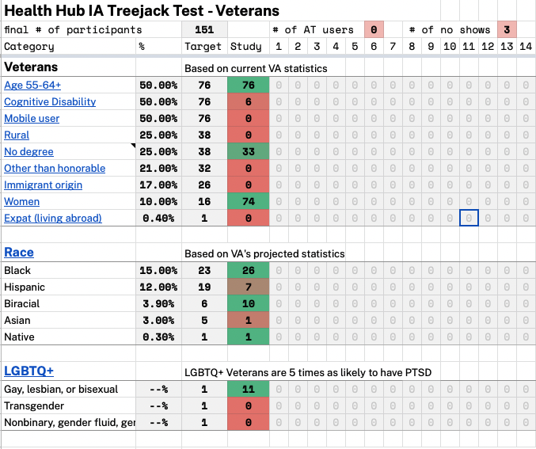
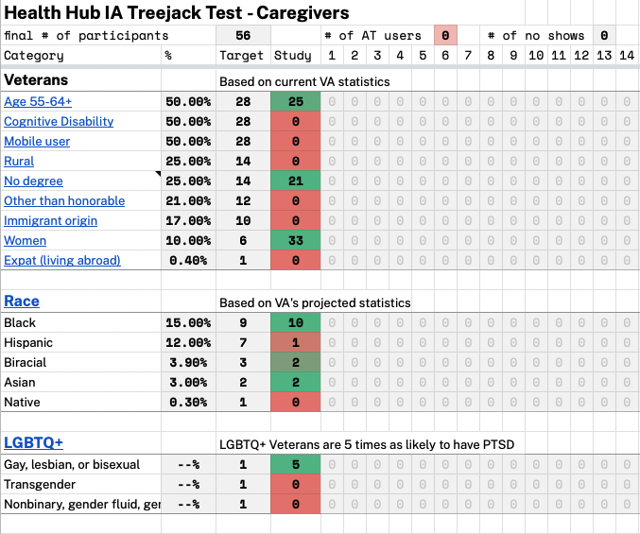
A
Analysis and synthesis of IA treejack test
User Story: Continue to monitor IA treejack test
User Story: Conduct deeper research analysis and synthesis of IA test #1
Key findings
Hypothesis 0 performed best on “manage tasks.”
For “get” tasks, there wasn’t a clear hypothesis that outperformed the other.
Hypothesis 0 had the most direct success with both Veterans and caregivers.
Hypothesis 1 tends to perform poorly except with caregiver cohorts
Hypothesis 0 performs poorly on “get” tasks likely because of labeling within the tree
Research synthesis
07-12 Sprint 6 Demo
HH
8

Slide 9
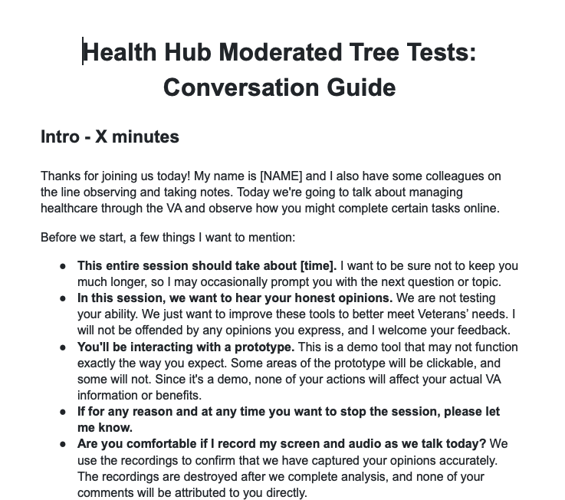
B
Research phase 2: Moderated research of tree test
User Story: Draft research plan #2 - moderated testing of IA tree
User Story: Draft conversation guide for research plan #2
Research Phase 2
Moderated tree test with 3 cohorts of 5–8 participants with Veterans health care, Veterans without health care, and caregivers/families
Draft - Research plan & conversation guide
07-12 Sprint 6 Demo
HH
9

Slide 10
1095-B Status Update
SPRINT 6 DEMO
07-12 Sprint 6 Demo

Slide 11

1095-B Workplan v7
Owned by design team
Owned by product/ engineering team
Release
WE ARE HERE
SPRINT 7
4/20 – 5/03
SPRINT 8
5/04 – 5/17
SPRINT 9
5/18 – 5/31
SPRINT 10
6/01 – 6 /14
SPRINT 11
6/15 – 6/28
SPRINT 13
6/29 – 7/12
SPRINT 14
7/13 – 7/26
SPRINT 15
7/27 – 8/09
SPRINT 16
8/10 – 8/23
SPRINT 17
8/24 – 9/6
1095-B: Spanish translation docs
Turnover document of remaining post-MVP work (VA notify, 2022 IRS form, 508 compliance, multiple year selection)
1095-B: Legal Review
1095-B: Legal Review – Opt-in
Product & Delivery
VA 508 Assistance request
MVP 508 Spanish translation docs
Kickoff
Align on launch MVP v. MVP w/ opt-in
User Experience & Design
Design for opt-in
Launch communication plan
Notification flow
Design for MVP 508 accessibility
1095-B Wayfinding
Build for 508 MVP
Tech feasibility wayfinding
Engineering & Development
Tech feasibility opt-in build
Build for wayfinding
Build Analytics for launch monitoring
Collaboration Cycle
Call center review – MVP 508
Staging review – MVP 508
1095-B Post launch evaluation
Sitewide and Content IA ticket opt-in
Sitewide and Content IA ticket MVP 508
MVP 508 Launch
07-12 Sprint 6 Demo
Workplan

Slide 12
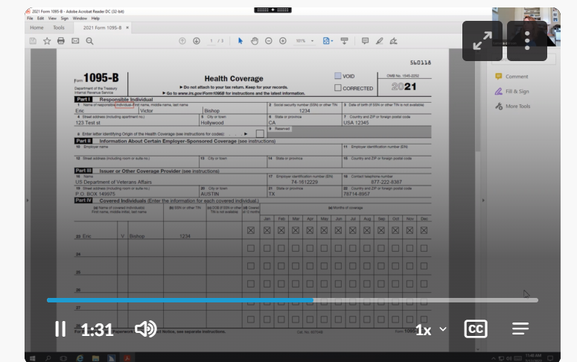
A
1095-B PDF analysis and troubleshooting
User Story: PM to f/u on VA 508 accessibility support ticket
User Story: Submit ticket to VA 508 office for screen read of 1095-B flat 6.30.22
User Story: Conduct screen reader testing with widget in staging and troubleshoot
Original product screen reader test
Template adjustments
Flat data
Unflatten data
We tried a new PDF writer (Hexapdf)
All 3 versions passed Adobe® Pro accessibility screen
All 3 version failed to read Veteran name
The 2 versions with Veteran data, Jaws failed to recognize any content in fields
The 1095-B PDF is very difficult to make accessible.
Ticket, video of Hexapdf test
07-12 Sprint 6 Demo
1095-B
12
Notes:
Shashank

Slide 13


B
MVP redesign for accessibility
User Story: Discovery into accessible MVP design re-do
User Story: Build additional MVP mock-up(s) based on feedback
User Story: Design accessible MVP (high-fidelity) for approval
Updated MVP design
“Hybrid” Form download (PDF & Text)
Opt-In element removed (not MVP)
Reviewed by accessibility and sitewide team
PDF version
13
07-12 Sprint 6 Demo
1095-B
Notes:
Thomas

Slide 14
C
Next steps…
Internal accessibility testing of text version
Build for hybrid PDF & text version of MVP
Finalize opt-in notifications flow
Enter collaboration cycle
Submit HEC documents for translation
07-12 Sprint 6 Demo
1095-B
14
Notes:
Munish

Slide 15
Blockers for 1095-B launch
BLOCKER | OWNED BY | ACTION NEEDED | DATE ENTERED | STATUS | NOTES
Legal Review Opt-in | Tarsha Tremble (Business Owner) | Business Owner is seeking a POC with the Office of General Counsel to understand requirements for legal review and timeline | Sprint 3 - 3/2/22 |  | MVP is approved, opt-in is still pending review
PDF Accessibility | Tarsha Tremble (Business Owner) | Team received PDF from IRS, but PDF is still not accessible once it is populated with data | Sprint 3 – 3/3/22 |  | Exception request denied, discovered IRS approved txt version
Translation Original MVP | Tarsha Tremble (Business Owner) | Follow up with translation progress of MVP materials | Sprint 7 – 4/20/22 |  | Resolved, will not need to submit
Translation Hybrid MVP | Tarsha Tremble (Business Owner) | Translation of new design with hybrid download options | Sprint 14 – 7/13/22 |  | Will not be a blocker for launch by VA-PO
07-12 Sprint 6 Demo
1095-B Blockers

Slide 16
1095-B Remaining actions, with external dependencies
ITEM | WORK STREAM | ACTION NEEDED | TARGET COMPLETE DATE | PREREQUISITE
Launch | Product & Tech | Work with tech to create a vets-website release | Aug | Hybrid MVP build for accessibility
UAT | Product & Tech | Follow Collaboration Cycle guidelines for UAT Identify Veterans within VA to conduct UAT, send access, and follow up to ensure testing complete | Aug | MVP dark launch
1095-B Opt-in | Product | Follow up with HEC and Profiles team to ensure 1095-B opt-in is done Follow up with Notifications team to ensure related SMS & e-mail notification flow is optimal Internal testing of text version of 1095-B Update draft communications and announcement plans, based on when opt-in will be launched | Oct | Ongoing collaboration meetings to align responsibilities and timeline
Notification Triggers | Design & Tech | Notification letters approved by legal Build triggers for opt-in, opt-out, annual update | Sep / Oct | Legal review
Legal Review | Product | Work with Tarsha to complete legal review for Opt-In | Oct / Nov | POC name from Tarsha. Legal package submitted by team and VA profile
Post MVP Launch Check- In | Product | Complete Collaboration Cycle milestone to KPIs post launch | TBD (One month after launch and announcement) | Product launched in prod
Links from VA.gov pages to 1095-B (wayfinding) | Product & Design | Work with IA team to have other identified pages within VA.gov (e.g., ACA page) link to the 1095-B page Work with IA team to have 1095-B page added to navigation and be found in VA.gov search | Aug / Sep | Product launched in prod; aligned on comm plan with Tarsha, Tracey
1095-B update strategy | Product | Align on who will own 1095-B long term, including updating the PDF template each year | Sept | Product complete and launched in production
Communications to announce launch | Product & Design | Work with Tarsha and HEC team to refine drafted communications and align on plan and timeline to announce 1095-B launch to Veterans Work with VA Notify team to build and launch communications on their platform | Aug | Product launched in prod; aligned on communication plan with Tarsha/Tracey
07-12 Sprint 6 Demo
1095-B Remaining actions

Slide 17
Sprint Deliverables
SPRINT 6 DEMO
07-12 Sprint 6 Demo

Slide 18
Sprint 6 Deliverables – Health Hub
EPIC | STORY | ESTIMATE | ASSIGNED | OUTPUT | REVIEWED W/ VA-PO | SPRINT TEAM GOAL COMPLETED?
Research | #42799 Continue to monitor IA treejack test (#1) | 2 | Carolyn | NR | 7/12/2022 | ✓
Research | #43275 Conduct deeper research analysis and synthesis of IA test (#1) | 8 | Carolyn Shashank | Research synthesis deck | 7/12/2022 | ✓
Research | #43825 Draft research plan #2 – moderated testing of H1 Tree | 3 | Carolyn Thomas Carl | Draft – research plan | 7/12/2022 | ✓
Research | #43826 Draft conversation guide for research plan #2 | 3 | Carl Carolyn | Draft – conversation guide | 7/12/2022 | ✓
07-12 Sprint 6 Demo
Sprint 6 Deliverables

Slide 19
Sprint 6 Deliverables – 1095-B
EPIC | STORY | ESTIMATE | ASSIGNED | OUTPUT | REVIEWED W/ VA-PO | SPRINT TEAM GOAL COMPLETED?
Opt-in | #42694 Sitewide content IA review of new design component – opt-in form 1095-B/VA Profile | 3 | Carl Thomas | Final approved opt-in design Ticket | 7/12/2022 | ✓
MVP | #43485 Conduct screen reader testing with widget in staging and troubleshoot | 8 | Teagan Tami Shashank | Ticket Hexapdf test video | 7/12/2022 | ✓
MVP | #43797 Submit ticket for VA508 office screen read of 1095-B flat 6.30.22 | 1 | Tami | RITM7165286 | 7/12/2022 | ✓
MVP | #43597 Discovery onto accessible MVP design re-do | 2 | Shashank Thomas Tami | NR | 7/1/2022 | ✓
MVP | #43650 Build additional MVP mock-up(s) based on feedback | 3 | Thomas Carl | Ticket | 7/1/2022 | ✓
MVP | #43594 Design accessible MVP (high-fidelity) for approval | 3 | Thomas Carl | Design | 7/12/2022 | ✓
MVP | #38709 Update call center documents to reflect changes to 1095-B MVP design | 3 | Carl | 1095-B FAQ Contact Center Review Guide HEC User Guide HEC Fact Sheet | 7/12/2022 | ✓
MVP | #43668 Build 1095-B MVP notifications in VA Notify | 5 | Carl | Screenshots VANotify Staging | 7/12/2022 | ✓
07-12 Sprint 6 Demo
Sprint 6 Deliverables

Slide 20
Sprint 6 Deliverables – 1095-B
EPIC | STORY | ESTIMATE | ASSIGNED | OUTPUT | REVIEWED W/ VA-PO | SPRINT TEAM GOAL COMPLETED?
MVP | #39722 PM to f/u on VA 508 accessibility support ticket | 1 | Tami | YourIT # RITM6608047 | 7/12/2022 | ✓
MVP | #38351 Collaboration cycle: Staging review [1095-B] | 0 | Munish | Ticket | 7/12/2022 | ✓
MVP | #41560 User acceptance criteria (UAT) 1095-B | 0 | Teagan Shashank | NR | 7/12/2022 | ✓
MVP | #36175 Collaboration cycle: Analytics implementation [1095-B] | 0 | Teagan Shashank | Ticket | 7/12/2022 | ✓
MVP | #38387 1095-B Team staging review accessibility checklist | 0 | Teagan Shashank | Ticket | 7/12/2022 | ✓
MVP | #40454 PM team to f/u w/ VA-PO on HEC documents being translated into Spanish | 1 | Tami | Ticket | 7/12/2022 | ✓
07-12 Sprint 6 Demo
Sprint 6 Deliverables

Slide 21
Preview of Sprint 7
SPRINT 6 DEMO
07-12 Sprint 6 Demo

Slide 22
Sprint 7 will focus on
 | Next sprint demo: July 26th
HEALTH HUB
*Stories subject to change during Sprint planning
Finalize research plan #2
Finalize conversation guide
Submit research plan for approval
1095-B
Build for hybrid PDF and text version of MVP
Collaboration cycle
Internal & 508 testing or text version of 1095-B
Finalize opt-in notifications flow
HEC documents for translation
07-12 Sprint 6 Demo
Preview of Sprint 7

Slide 23
Appendix
SPRINT 6 DEMO
07-12 Sprint 6 Demo

Slide 24
Project risks and mitigation strategies (1 of 2)
RISK AND IMPACT | MITIGATION STRATEGY | DATE |  | STATUS | NOTES
 |  | ENTERED | CLOSED
IRS stakeholder is outside of VA ecosystem. Building without guidance or legal review regarding compliance with IRS regulation could result in risk. | Conduct research on available information surrounding current IRS 1095-B tax form regulations. Seek legal review through VA resources as directed by VA-PO and Business Owner | 1/20/22 | 2/11/22 |  | VA Business Owner clarified that IRS review is not needed
Team had previously confirmed with Business Owner that legal review was not needed. Business Owner clarified that legal review would be needed as of March 2nd | Business Owner is seeking a POC with the Office of General Counsel to understand what is needed and potential launch impact | 3/2/22 | 5/17/22 |  | Launch blocker
Data requires storage in a S3 bucket that the enrollment system can have access to in production; process to create the staging and production bucket does not have a clear timeline. Without the S3 bucket in prod with enrollment system access, product cannot be built in prod | Daily follow-ups with Jesse House and Mike Chelan (infrastructure team) | 3/1/22 | 3/24/22 |  | S3 bucket now in place. Risk resolved.
Business owner raised User Acceptance Testing should be done with HEC Call Center | Requested Business Owner to schedule UAT with required individuals for mid-March and book as early as possible | 3/2/22 | 3/25/22 |  | Business owner confirmed that UAT can be done through Collaboration Cycle and does not have to be done with HEC team
Feedback from Content and IA Review has taken over a week to come in; feedback is changing our proposal for the H1 and delaying confirmation of where the 1095-B landing page should live, which in turn delays our ability to complete the front end (top nav and side nav bars) | Design team pushing on IA team to confirm final answer of where 1095-B landing page should live and what the H1 header title should be | 03/04/22 | 3/8/22 |  | URL confirmed 3/7 EOD; IA review now closed
Designs were approved as part of Midpoint Review. Afterwards, Sitewide Content stated they would need to build our front end in Drupal and change our designs, impacting our in-flight build. | Design team met with Sitewide Content to align on redesigned front end. Tech working with Sitewide Content to send over our dynamic widget to be pulled into their static front end. Sitewide Content now owns the front end build. | 3/10/22 |  |  | Launch date dependent on Sitewide Content ability to launch front end

Slide 25
Project risks and mitigation strategies (2 of 2)
RISK AND IMPACT | MITIGATION STRATEGY | DATE |  | STATUS | NOTES
 |  | ENTERED | CLOSED
HH Tree Test design held up due to new information from Meg, Danielle and Mikki. | VA and MO team could work in collaborative sessions so that work is not duplicated, and we can arrive at a test design that works by the end of Sprint 3 | 5/16/22 | 5/26/22 |  | Awaiting version of ‘manage’ tree that we can incorporate into research trees in order to move forward with research plan
HEC Legal review required for 1095-B Opt-in | Opt-in is being built by VA Profile team | 3/2/22 |  |  | Post-MVP enhancement blocker
07-12 Sprint 6 Demo

Slide 26
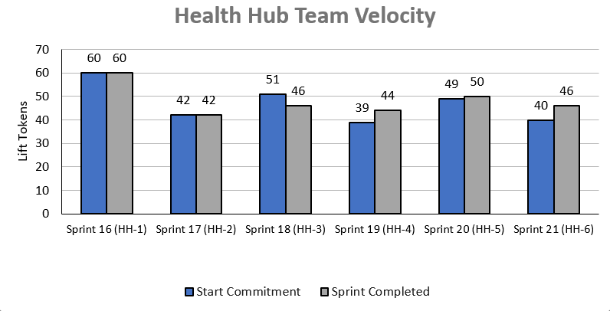
Health Hub Team velocity
 | Velocity details Velocity estimated in story points, using Fibonacci Velocity in Sprint 6 accounted for 7 team members 46 total story points were completed; Team committed to 40 story points at beginning of the sprint. 2 Stories added (6) draft moderated research plan and conversation guide 4 stories blocked (0) pending IRS accessibility solution
07-12 Sprint 6 Demo
Appendix
26

Slide 28
A
Lorem
User Story: Lorem
User Story: Lorem
User Story: Lorem
User Story: Lorem
User Story: Lorem
Lorem
Lorem
Lorem
Lorem
Lorem
Lorem
Lorem
Link
07-12 Sprint 6 Demo
Lorem
28

Slide 29
A
Lorem
User Story: Lorem
User Story: Lorem
User Story: Lorem
User Story: Lorem
User Story: Lorem
Lorem
Lorem
Lorem
Lorem
Lorem
Lorem
Lorem
Link
07-12 Sprint 6 Demo
Lorem
29

Slide 30
A
Lorem
User Story: Lorem
User Story: Lorem
User Story: Lorem
User Story: Lorem
User Story: Lorem
Lorem
Lorem
Lorem
Lorem
Lorem
Lorem
Lorem
Link
07-12 Sprint 6 Demo
Lorem
30

Slide 31
Sprint __ Deliverables – __
EPIC | STORY | ESTIMATE | ASSIGNED | OUTPUT | REVIEWED W/ VA-PO | SPRINT TEAM GOAL COMPLETED?
R | #40000 Lorem | 0 | C | Lorem Lorem Lorem Lorem Lorem | 7/12/2022 | ✓
R | #40000 Lorem | 0 | C | Lorem Lorem Lorem Lorem Lorem | 7/12/2022 | ✓
R | #40000 Lorem | 0 | C | Lorem Lorem Lorem Lorem Lorem | 7/12/2022 | ✓
R | #40000 Lorem | 0 | C | Lorem Lorem Lorem Lorem Lorem | 7/12/2022 | ✓
R | #40000 Lorem | 0 | C | Lorem Lorem Lorem Lorem Lorem | 7/12/2022 | ✓
R | #40000 Lorem | 0 | C | Lorem Lorem Lorem Lorem Lorem | 7/12/2022 | ✓
R | #40000 Lorem | 0 | C | Lorem Lorem Lorem Lorem Lorem | 7/12/2022 | ✓
R | #40000 Lorem | 0 | C | Lorem Lorem Lorem Lorem Lorem | 7/12/2022 | ✓
R | #40000 Lorem | 0 | C | Lorem Lorem Lorem Lorem Lorem | 7/12/2022 | ✓
R | #40000 Lorem | 0 | C | Lorem Lorem Lorem Lorem Lorem | 7/12/2022 | ✓
07-12 Sprint 6 Demo
Sprint 5 Deliverables

Slide 32
Sprint 1 will run April 20 to May 3rd
Owned by design team
Owned by product/ engineering team
Release
WE ARE HERE
SPRINT 1
SPRINT 2
SPRINT 3
SPRINT 4
SPRINT 5
Week 1: 04/20 – 04/26
Week 2: 04/27 – 05/03
Week 3: 05/04 – 05/10
Week 4: 05/11- 05/17
Week 5: 05/18 – 05/24
Week 6: 05/25 – 05/31
Week 7: 06/01 – 06/07
Week 8:
06/08 – 06/14
Week 9: 06/15-06/21
Week 10: 06/22-06/28
Product & Delivery
1095-B: Identify Change Management or Communications Plan
1095-B: Legal Review
1095-B: Handover plan - Prepare for launch
1095-B: Opt-in follow up
1095-B: Spanish translation docs
HH: Charter
HH: Develop backlog + Vision Framework
HH: Roadmap
User Experience & Design
1095-B: Wayfinding plan
Testing prep & recruiting
Voice of Veteran
Voice of Veteran
HH: Discovery
HH: Stakeholder Interviews
HH: Current State Journey Map
Prioritized plan
Engineering & Development
HH: Tech discovery
HH: Stakeholder Interviews
HH: Proposed tech integrations based off research findings
Collaboration Cycle
Midpoint Review
1095-B: Launch Date Dependent on Legal Review Completion
Research Plan Review
Research Plan Review
*Does not show post-MVP Validate phase meetings in Collaboration Cycle, such as Full Accessibility Audit and Post-Launch Check In; Contact Center Review adjusted to 3 weeks before launch as approved by Jason Woodman
Preview of Sprint 7

